Slide 1
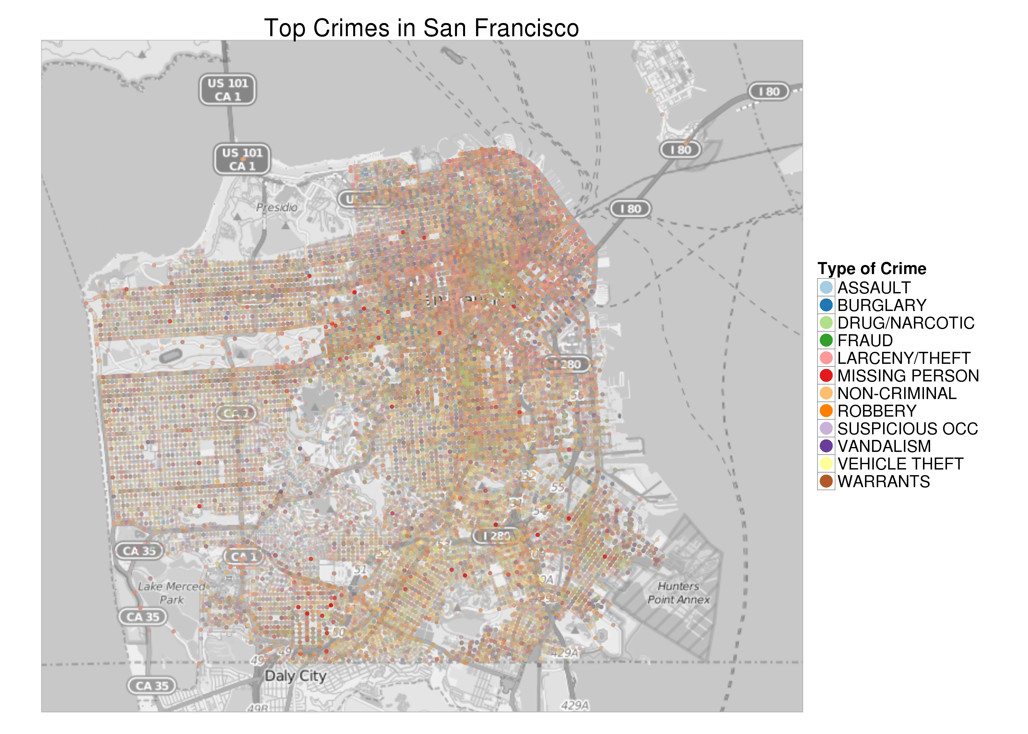
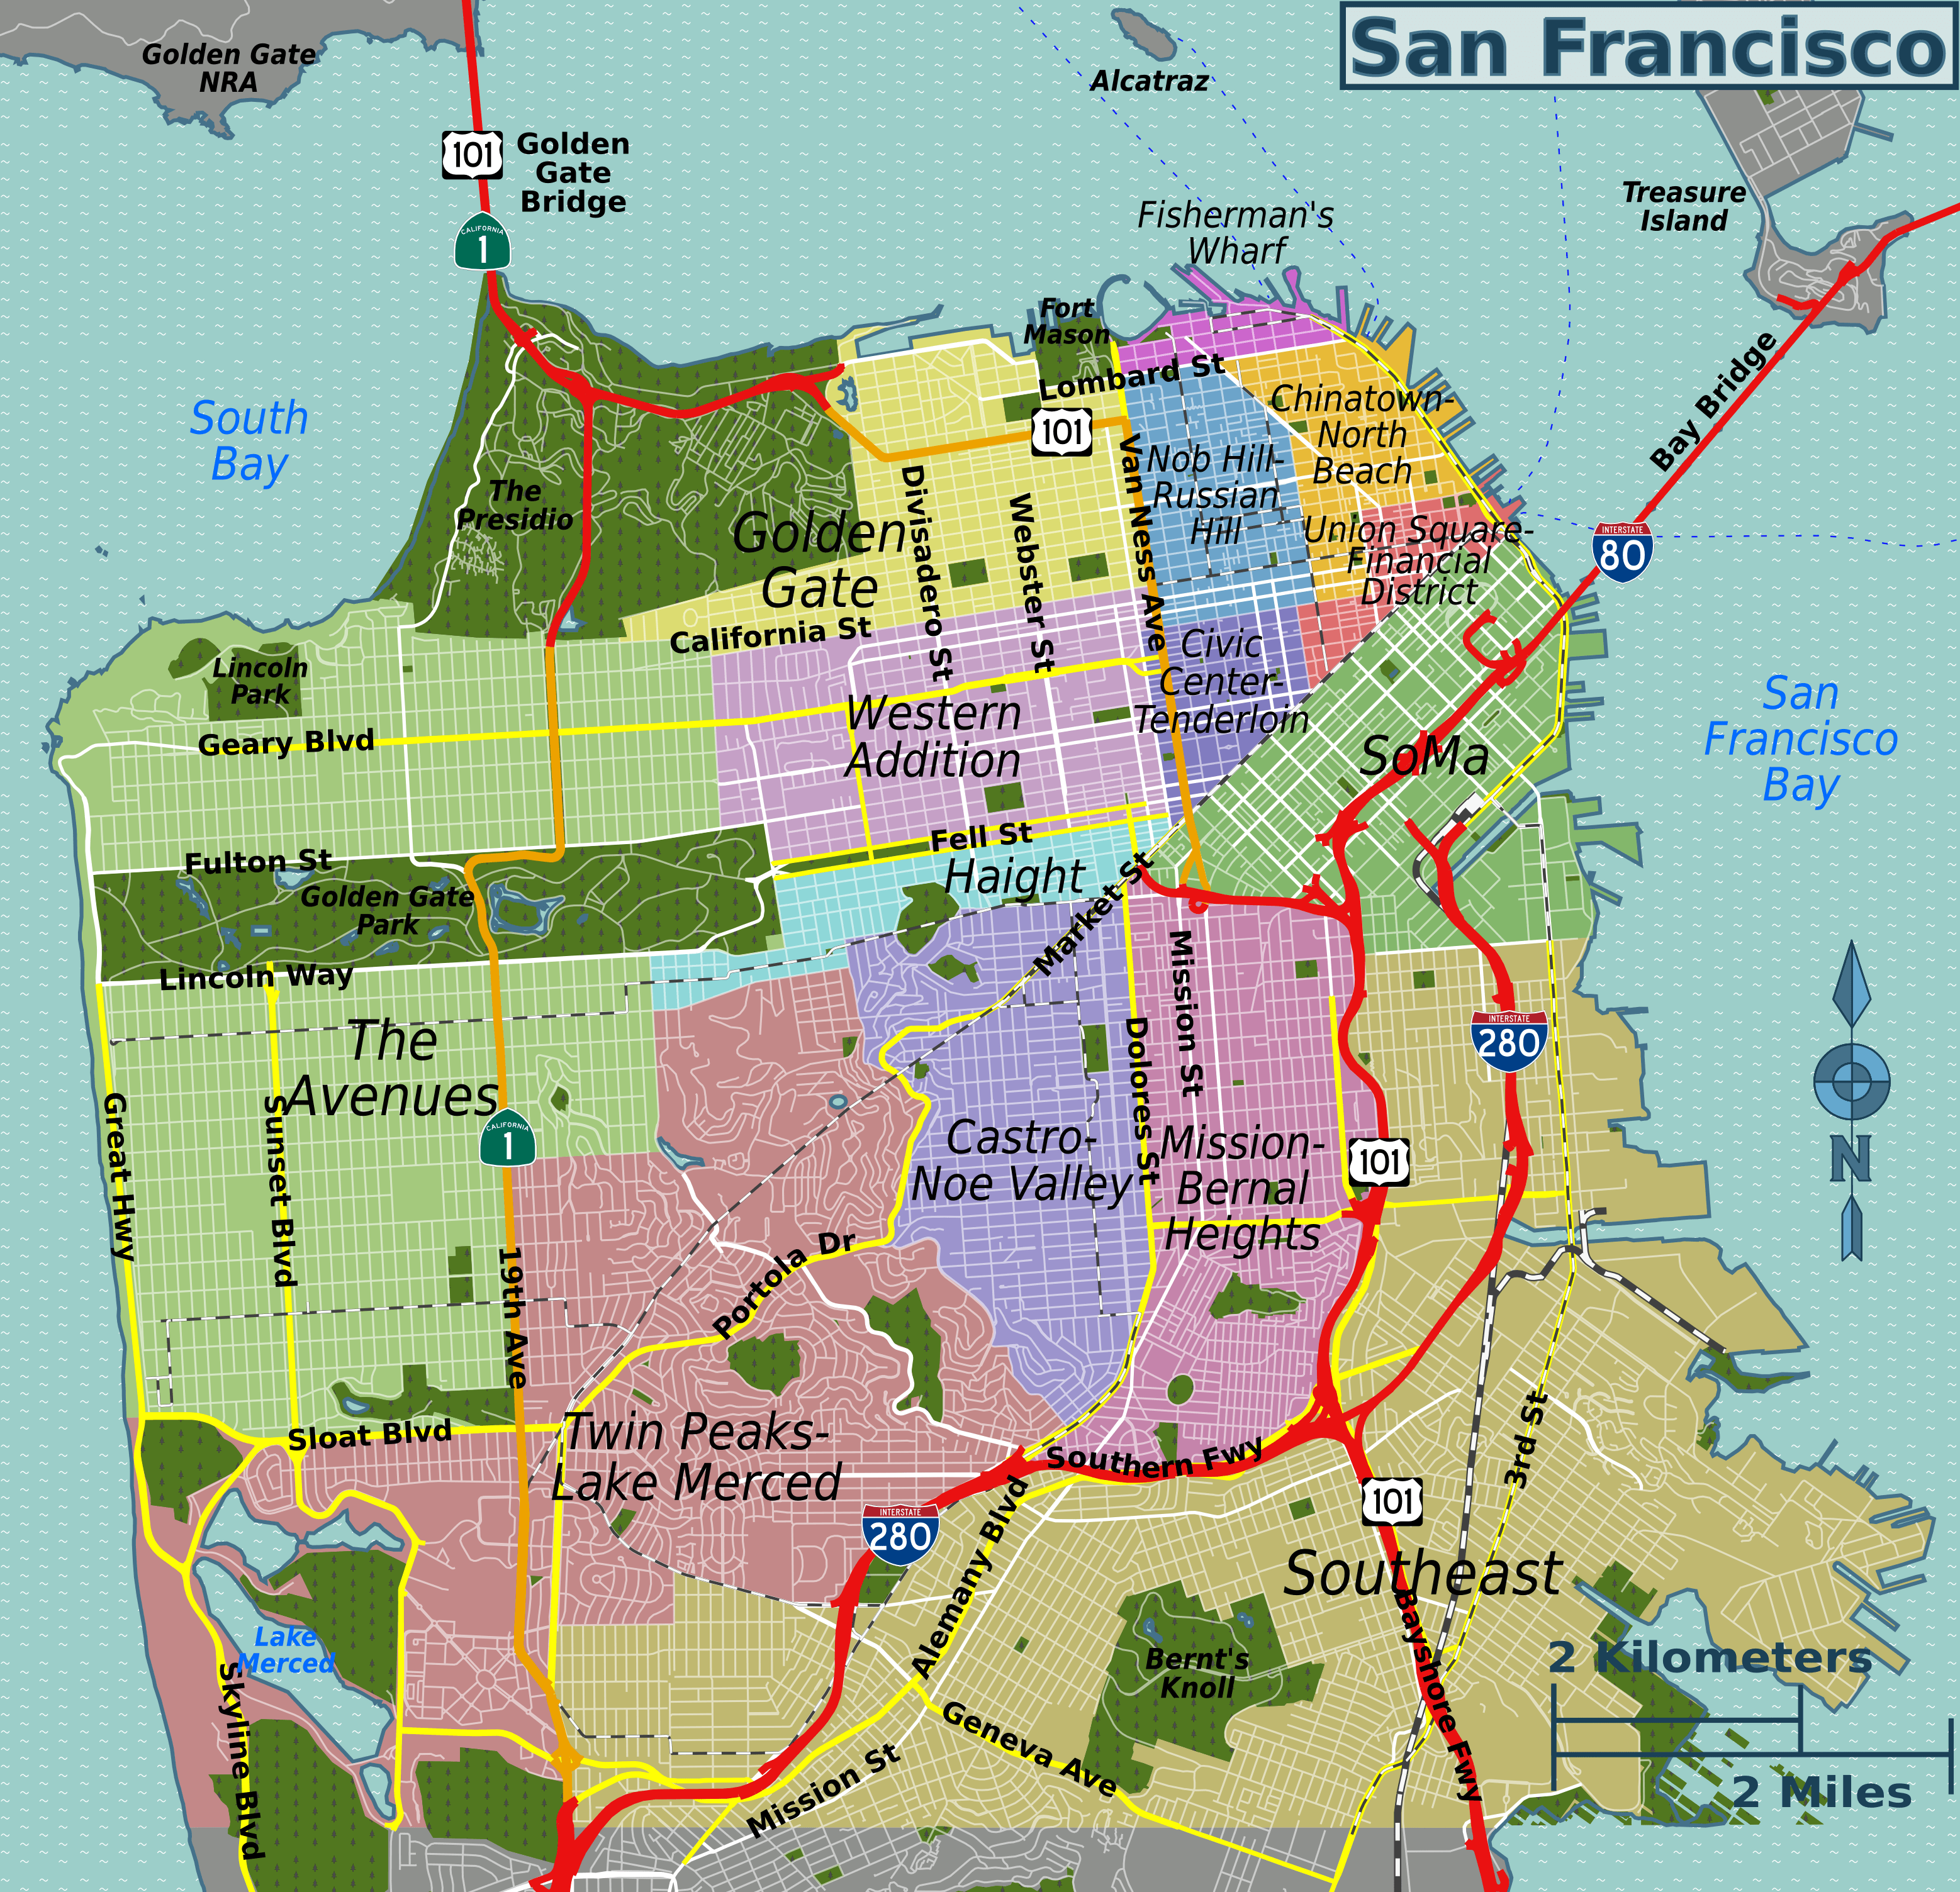
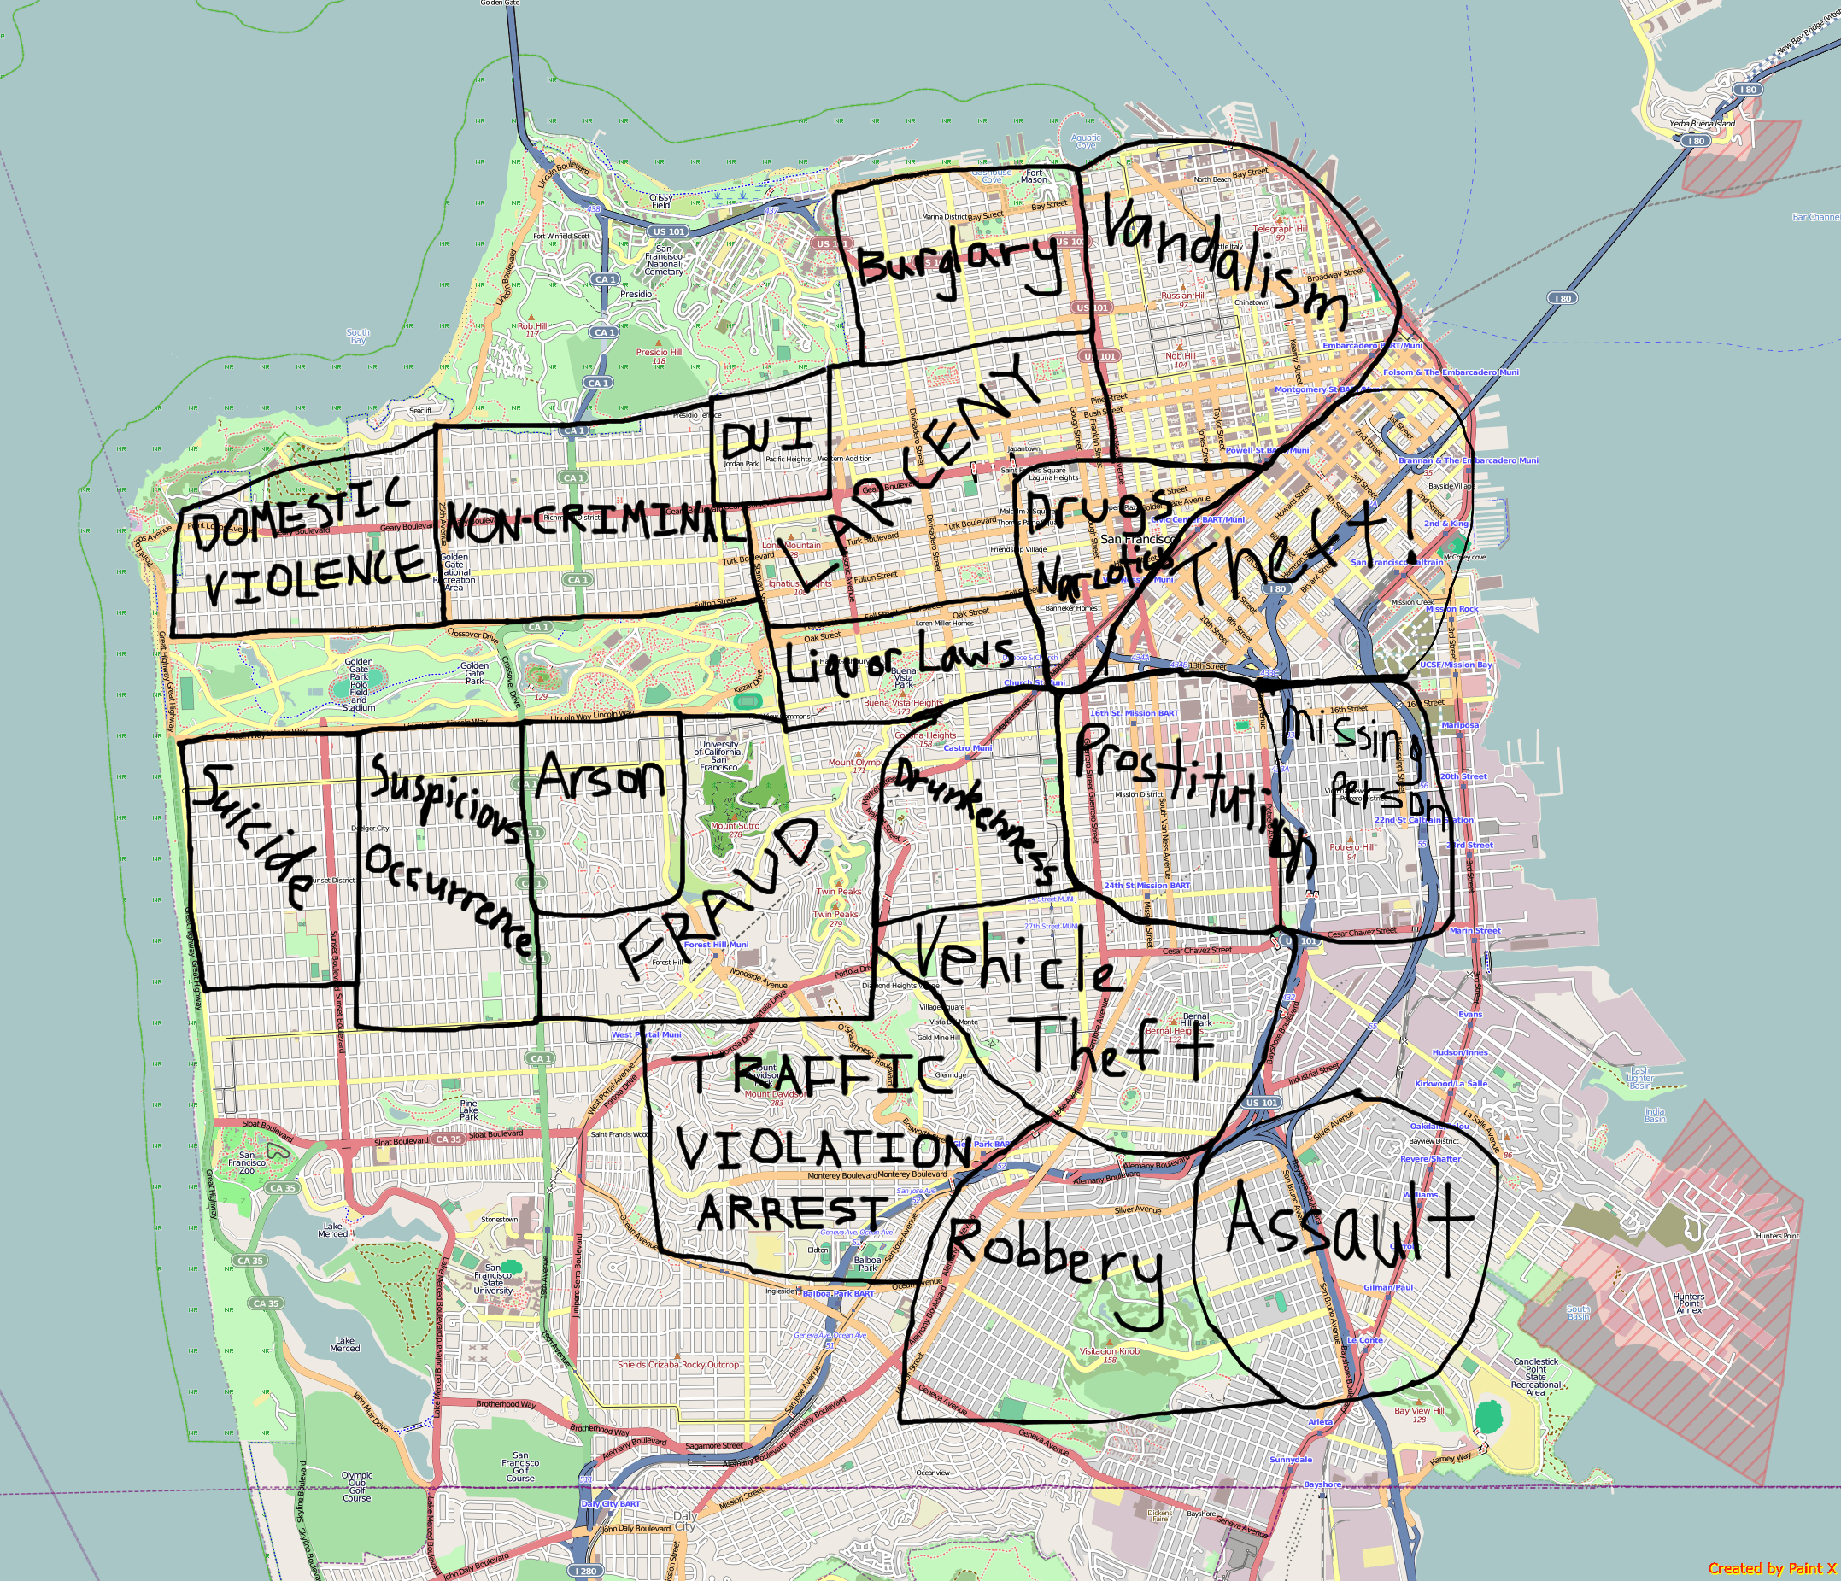
Predicting Crime Category In San Francisco Bay Area
Group Members: Anindita Mozumder James Morgan Nithin Reddy Prashant Sharma Santhosh K Jagadish Srikar Potta Stuti Nanda

Slide 2
Predicting Crime Category In San Francisco Bay Area
Group Members: Anindita Mozumder James Morgan Nithin Reddy Prashant Sharma Santosh K Jagadish Srikar Potta Stuti Nanda

Slide 3
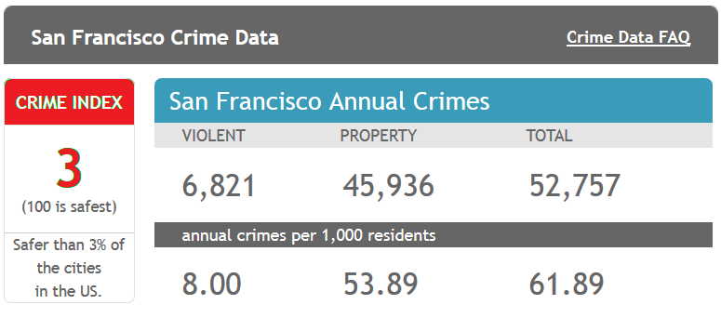
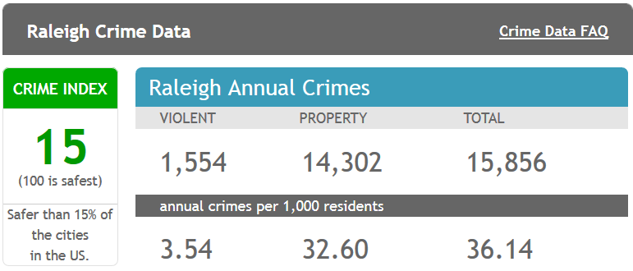
Background
From 1934 to 1963, San Francisco was infamous for housing notorious criminals
Rising wealth inequality, housing shortages responsible for increasing crime rate
The Kaggle’s dataset provides nearly 12 years of crime reports from across all of San Francisco's neighborhoods
Source: http://www.neighborhoodscout.com/ca/san-francisco/crime/

Slide 4

Objective
Given the historical crime data (time and location) predict the category of crime that occurred.
Utilize skills and knowledge gained in CSC522 to
Perform EDA to understand training data
Select and implement set of classification algorithms
Validate and Evaluate classification models
Predict the Crime Category

Slide 5
State of the art

Slide 6
Logistic Regression

Slide 7
Classification using Bagging
Tuning parameter: Mode
We began with Decision tree but the accuracy was low
We tried random forest too
Bagging was most suitable where we varied the distribution of the samples
Class Label was the mode of the results of the iterations

Slide 8
Other Methods Used
SVM
Neural Networks

Slide 9
Results (max: 2 slides)
Classifier | Accuracy | Methodology | Top Recall | Top Precision | Pros/Cons
Decision Tree | 66.06% | R/Weka | 80.92% | 67.33% | Cons- tree size very big
SVM | 63.09% | R | 75.93% | 65.85%
Neural |  | R |  |  | Cons- very expensive Pro-Better results
Random Forest | 70.833% | R/Weka | 72.37% | 80.40% | Cons- Computationally more expensive. Pros- better results than decision tree
Logistic Regression | 62.37% | R | 77.92% | 40.92%
Decision Tree with Bagging | 65.23% | R | 80.23% | 44.52%
Logistics Regression* | 58.67% | R | 89.68% | 16.19%

Slide 10
Results (max: 2 slides)
Add a graph: accuracy of each of he methods vs time line

Slide 11
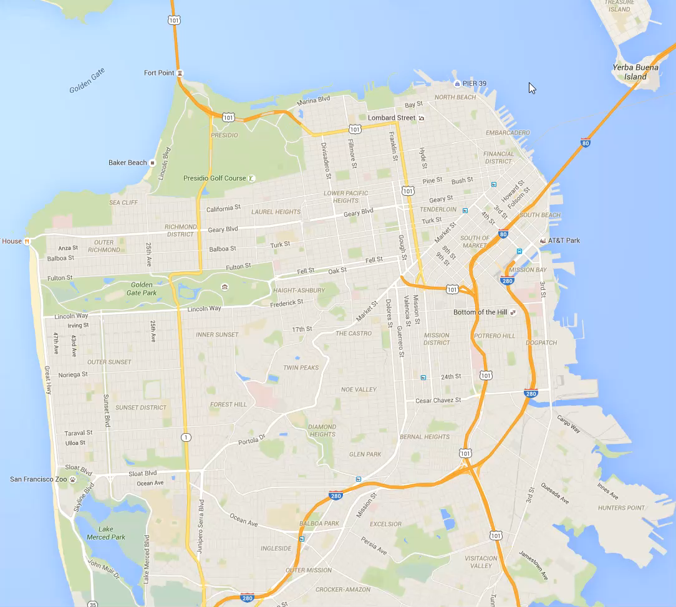
Visualization of Data
-Dataset shown by type of crime, day of week, and surrounding police district
-Visualization aids in understanding data and identifying trends
-Can be used for practical application by end-users (Planning, resource management, etc…)

Slide 12
Conclusions and Future Work
In this project, we learned than the most common crimes in San Francisco are larceny/theft and other minor crimes such as vandalism
With better classification techniques, we could try to improve the accuracy further
The team worked consistently and fulfilled its objectives. An improvement can be that we try other classification techniques

